Slide 1

Improving SONA Experience

Slide 2
Current System
Currently, all the studies participation is handled through the methods modules.
Y1S1: Psychology as a Science (PaaS)
5% of overall mark
10 SONA credits (2.5 hours of participation)
Y1S2: Analysing Data
10% of overall mark
20 SONA credits (5 hours of participation)
Y2S1: Discovering Statistics
5% of overall mark
10 SONA credits (2.5 hours of participation)
Y2S2: Quantitative and Qualitative Research Methods (QQM)
5% of overall mark
10 SONA credits (2.5 hours of participation)
20% of credits must be from in-person studies (or live Zoom studies) - unless disability support.
Marks are pro-rated to the number of credits (e.g., having 75% of credits = 75% of the full mark)
Every study must send an email (goes to Ed) about:
Expected sample size
Duration of the recrutement phase
Was put in place to gather data on studies availabilities
Notes:
https://canvas.sussex.ac.uk/courses/3317/pages/participating-in-research

Slide 3
The Problem
For students
No benefits
“Learning about the study”: The typical debriefing is often minimal and arguably, students don't care much.
“Learning about the research process”: No reflection around the participation. Potential benefits in terms of research experience not obvious to communicate to students (in general, students don't always see the immediate benefits of what they need to do).
Not enough studies
Especially for some groups (mature students, disorders, etc.)
Stressful & frustrating experience
For researchers
Bad data quality
Main impact on poor researchers (PhD students/ECRs) who can't afford other platforms and rely on SONA data for their research
Researchers/Participants Disconnection
Often no upstream feedback from the participant to the researcher. No opportunities for improvement of study design.
Gap

Slide 4
Alternative Models
What does Prolific do?
Flag participants that have been rejected (system of voluntary "return")
Ultimately risk of being banned from the platform

Slide 5
Solutions
How to increase value for students?
How to increase value for researchers?

Slide 6
ACTION I
Value for students
Showcase the people behind the studies
Add one page at the end of experiments about researcher
Each study must include a final page about the researcher (e.g., a PhD student) running the study, that says a few words about their background and career trajectory (how they ended up doing this study).
Goal:
Increase the connection with the staff
Provide career ideas
Humanize the studies (convey the idea to participants that real people depend on good data)
Meet the researcher!
Hi, I’m Dom 👋
I’m currently a PhD student working with Prof. X.
How did I become a researcher?
I did my undergrad at Sussex, and during my 3rd year I realized that I enjoyed a module on sports psychology. I then got in touch with Professor X, who suggested to…
Why am I hoping to get from this study?
The results of this study will be analysed and included in my thesis on “the benefits of red wine on mood ”.
Notes:
People like to know about people, e.g., star of the week in the bulletin became arguably one of the fav part.

Slide 7
ACTION II
Value for students
“Put yourself in the shoes of the researcher”
Make participants produce a small report
Each student must write a short report about a study they participated in, with
A couple of sentences about what you understood the study was about.
Positive aspects (things that you enjoyed, questionnaires that you liked)
What would you improve? User experience, research design, …
Goal:
Active engagement in studies
Increased reflection from the students
Feedback for researchers
Outstanding question:
How to implement that at a minimal marking (staff) cost?
Alternative: Mandatory feedback
Each study must add a “Feedback” free form input at the end for the participant to write. It is “checked” by the researcher and if left blank, penalty (see action IV).
Cost on researchers

Slide 8
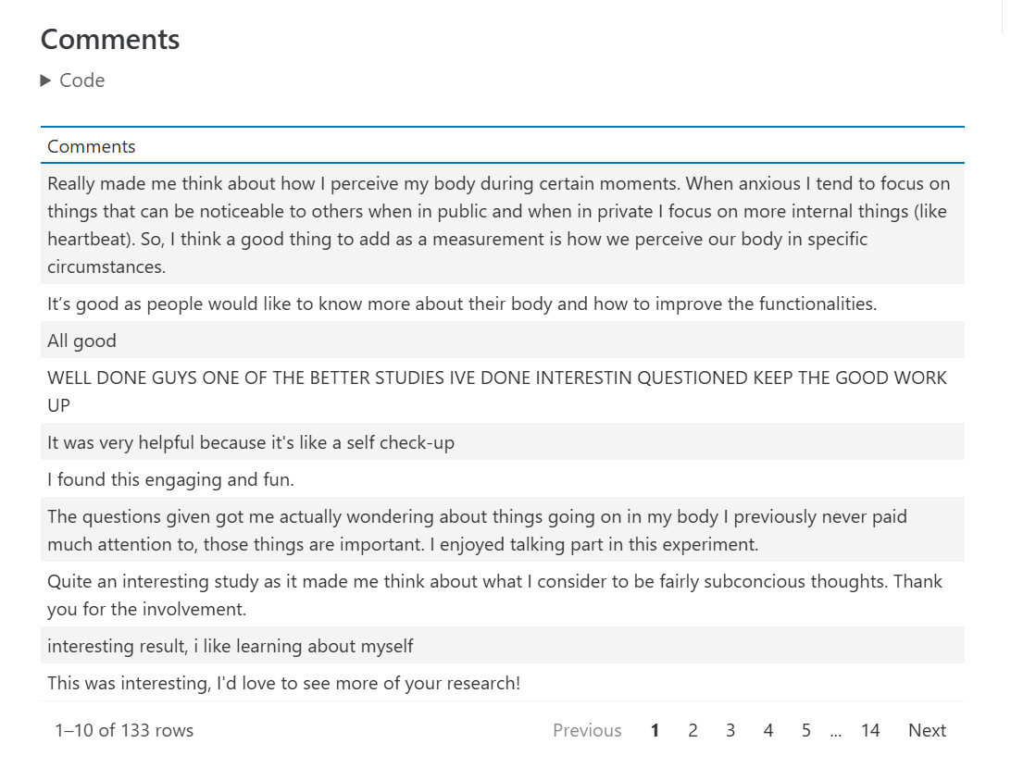
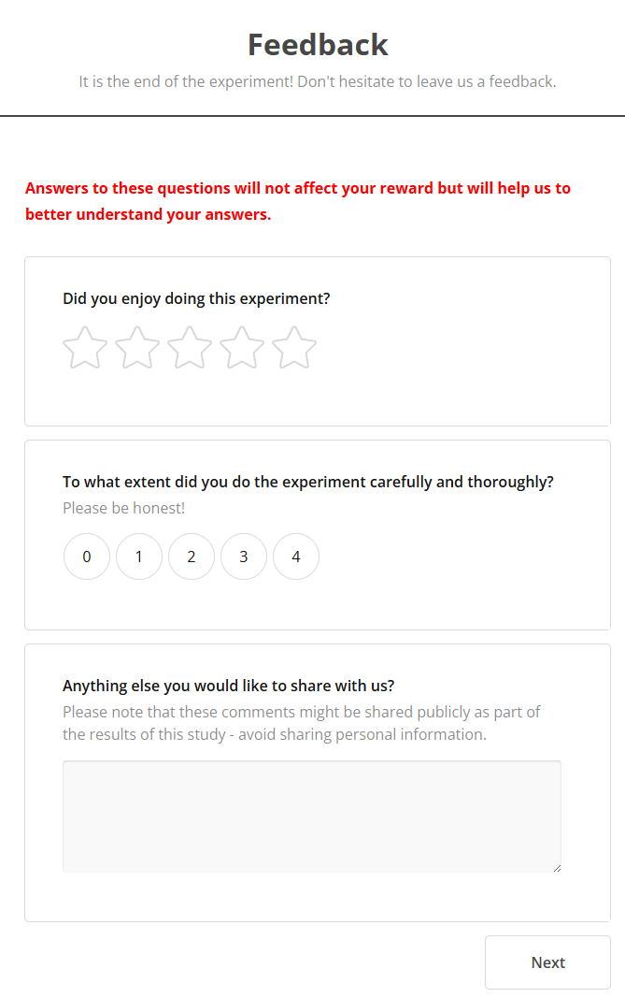
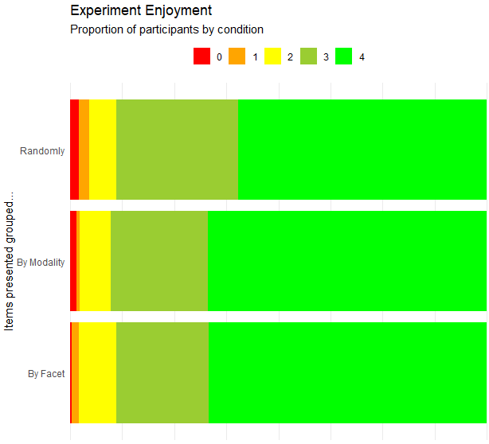
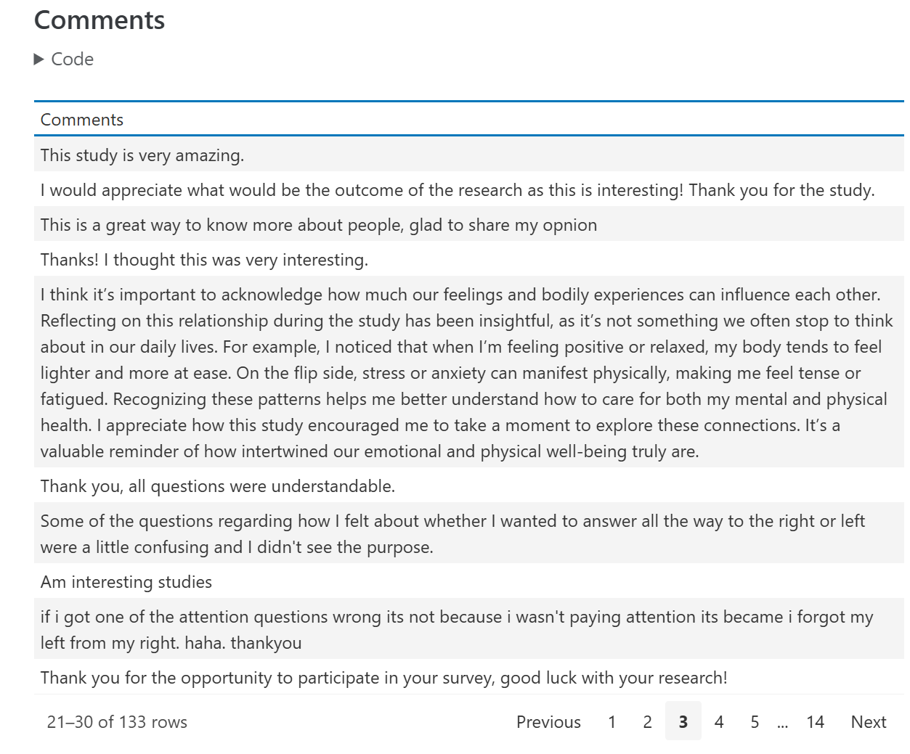
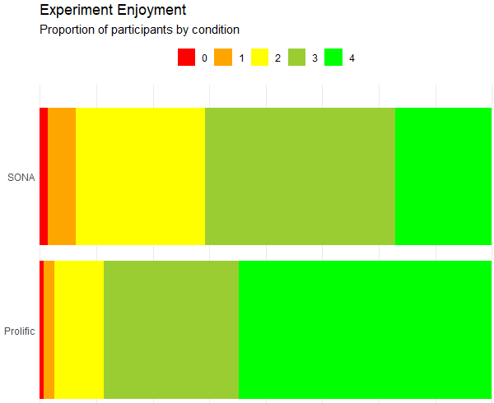
Feedback
Notes:
My personal experience with implementing feedback
~15% lower enjoyment for SONA

Slide 9

ACTION III
Value for students
Make more studies accessible
Decrease online studies inclusion criteria
For online studies:
Minimize inclusion criteria (and use them as exclusion criteria a posteriori)
Age (minor)?
Make usage of the screening criteria in SONA
Decide on a couple of “megastudies” that run for years?
What to include? Risk of unfairness
Every ~3 years, “Sussex Megastudy” meeting to design/update?
Additional benefit: Creates a large pool of data for dissertation students to use
Review process for Screening questionnaires
System of RA on SONA underutilized
Notes:
JennifR: « The idea was to build a few topic-focused studies - like a cog study, a social study, etc. - not only to avoid accessibility restrictions but also so that there would be a large pool of data for dissertation students to use, as there's also a workload equality issue for (particularly) E&S staff who are more likely to have no lab, no PhD/postdocs, no backlog of data, and no existing infrastructure to easily help their dissertation students do data collection.”
Take experiments within class

Slide 10
ACTION IV
Value for researchers
Currently:
After 1 no-show: -1 credit
After 2 no-shows, account gets locked + threatening email
Make the penalty transparent, explicit, and immediately tangible with objective criteria
No-shows (in-person)
Low effort (failed attention checks)
Enforce penalties
No auto-crediting (conditional crediting instead)
System of negative credits as a penalty (flat rate of -1 to avoid being overly harsh)
+3 credits
Attention checks passed
Online no-show
No feedback (see action II)
Attention checks failed
In-person no-show
0 credits
-1 credits
Of course, we keep some flexibility (i.e., crediting happens at the researcher’s discretion) for particular cases
Participant complaints:
« I did do it properly but I had a technical issue »
Participants should be instructed to take a screenshot of the validation screen & any technical issue
Notes:
The Benefits and the penalties must be transparent, eloquent, and immediate.
The current system of “flagged” for no-shows is obscure and does not act as a deterrent.
The attention checks should be reasonable (if > 25% failure, it’s probably that it’s too hard) -> action V on good study design.

Slide 11

ACTION V
Value for researchers
SONA training
“Build good online studies” workshops
Learn how to set-up conditional crediting
How to set-up feedbacks
Run as part of the MORSE (Methods for Open and Reproducible Science) group
Mandatory workshop part of the PhD induction?
Supported by the research technicians?
Martha + Max
Notes:
With the help of the psychology software team

Slide 12


Summary
Action I: « Meet the researcher » page
Participants get to know who’s behind the study
Action II: Mandatory Feedback
Participants must share their experience and suggests improvements
Action III: Less inclusion criteria
Researchers can exclude participants a posteriori
Action IV: Enforced Explicit Penalties
Minus credits if low-effort participations or in-person no-shows
Action V: Staff Training
Help researchers design and implement good SONA studies
Outstanding question:
Who checks that these actions are in-place?

